Slide 1
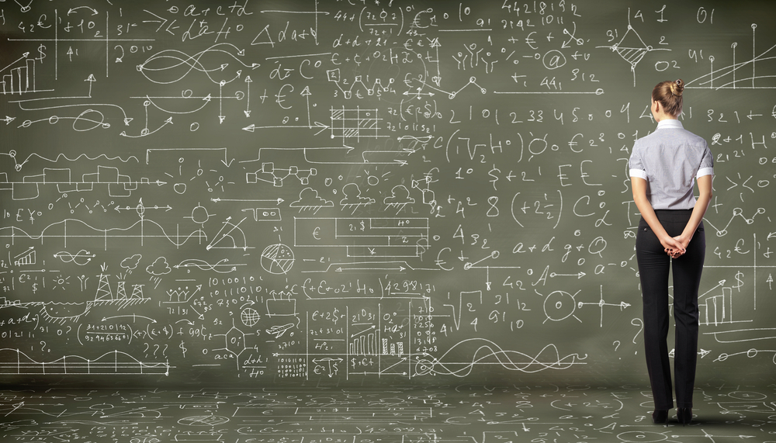
A (Very) Brief Introduction to Machine Learning http://blog.indeed.com/2018/08/23/artificial-intelligence-report/
David Meyer
SP CTO and Chief Scientist
Brocade
dmm@brocade.com

Slide 2
What is Machine Learning?
The complexity in traditional computer programming is in the code (programs that people write). In machine learning, algorithms (programs) are in principle simple and the complexity (structure) is in the data. Is there a way that we can automatically learn that structure? That is what is at the heart of machine learning.
-- Andrew Ng
That is, machine learning is the about the construction and study
of systems that can learn from data. This is very different than
traditional computer programming.

Slide 3
The Same Thing Said in Cartoon Form
Traditional Programming
Machine Learning
Data
Computer
Output
Program
Data
Computer
Program
Output

Slide 4

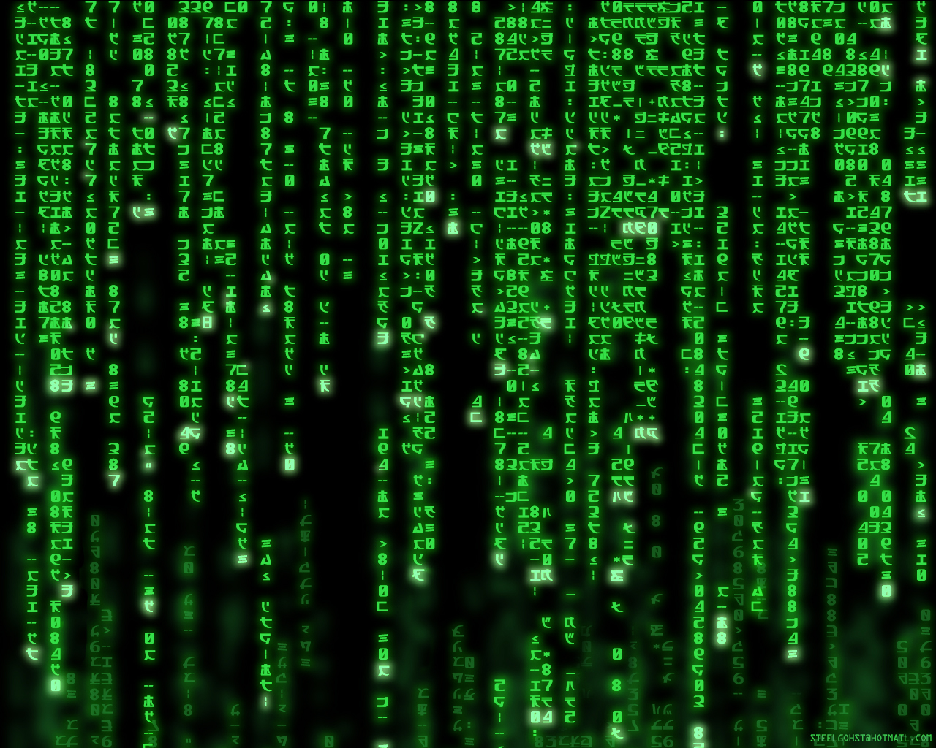
Why Machine Learning is Hard
You See
Your ML Algorithm Sees

Slide 5
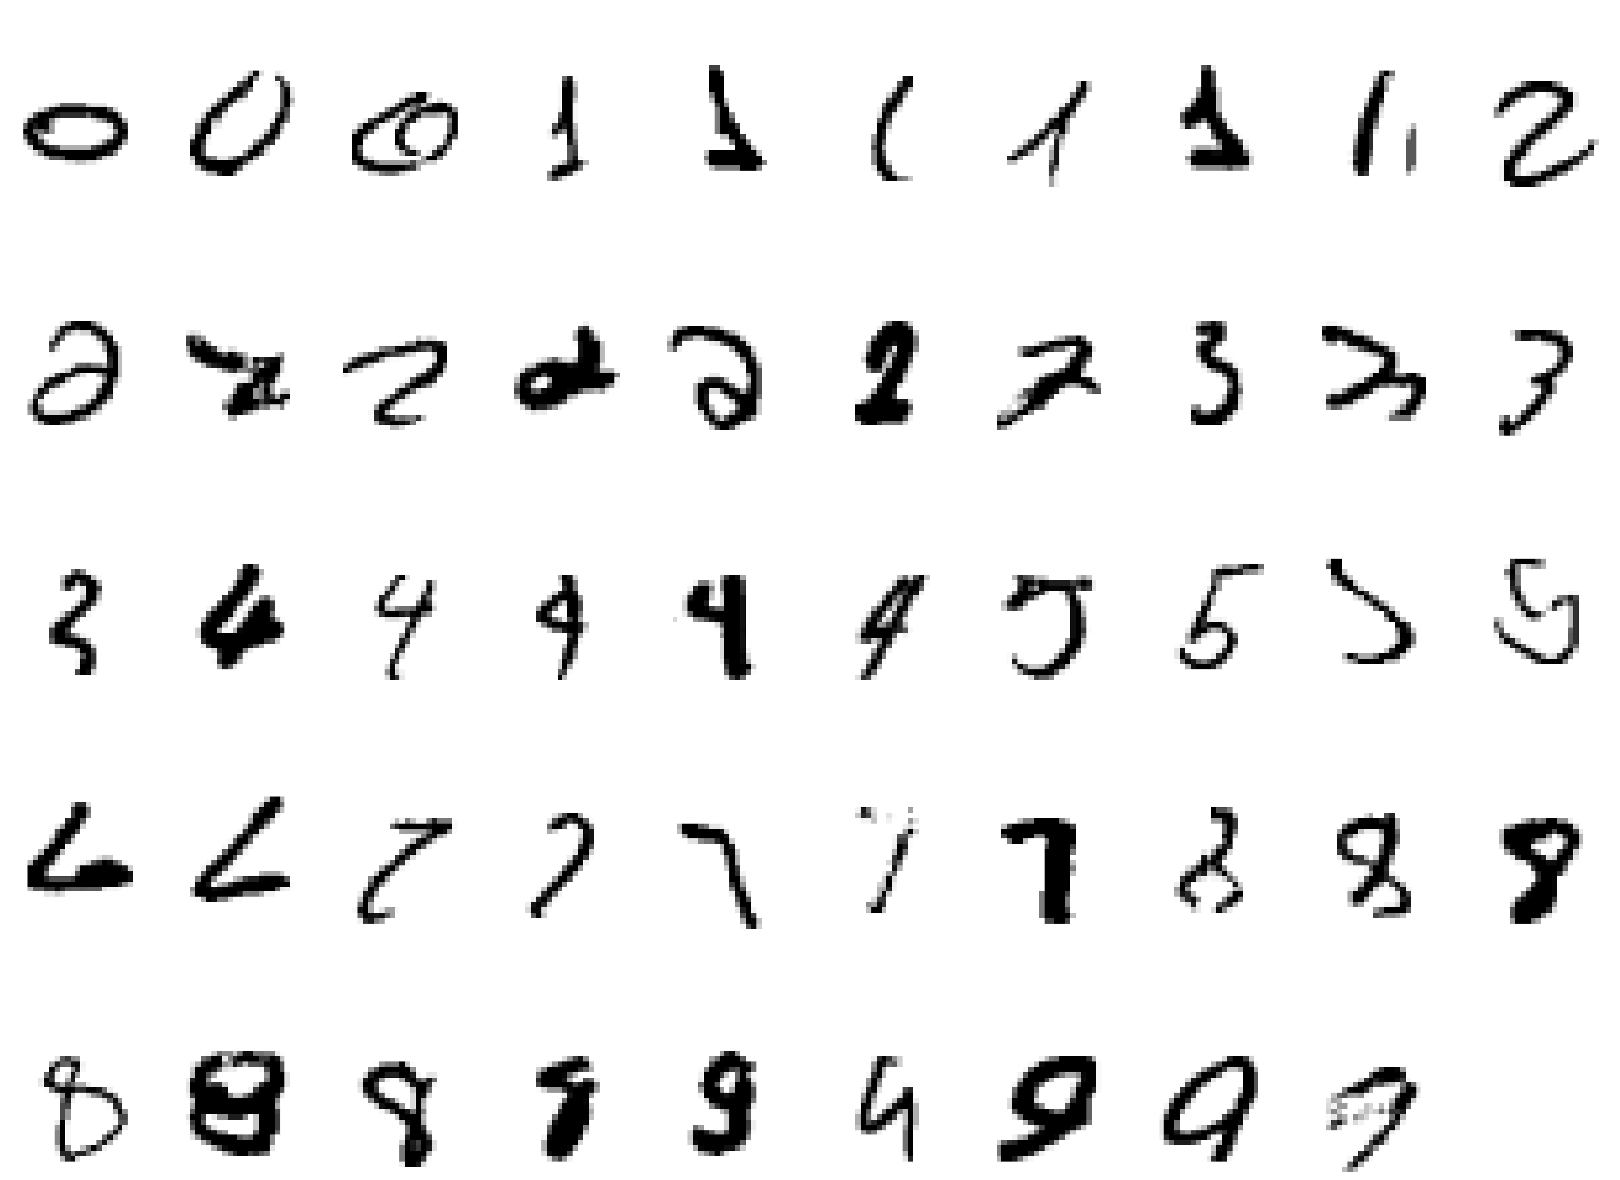
Why Machine Learning Is Hard, Redux What is a “2”?

